Slide 1
Policy Search
Dr Prashant Aparajeya

Slide 2
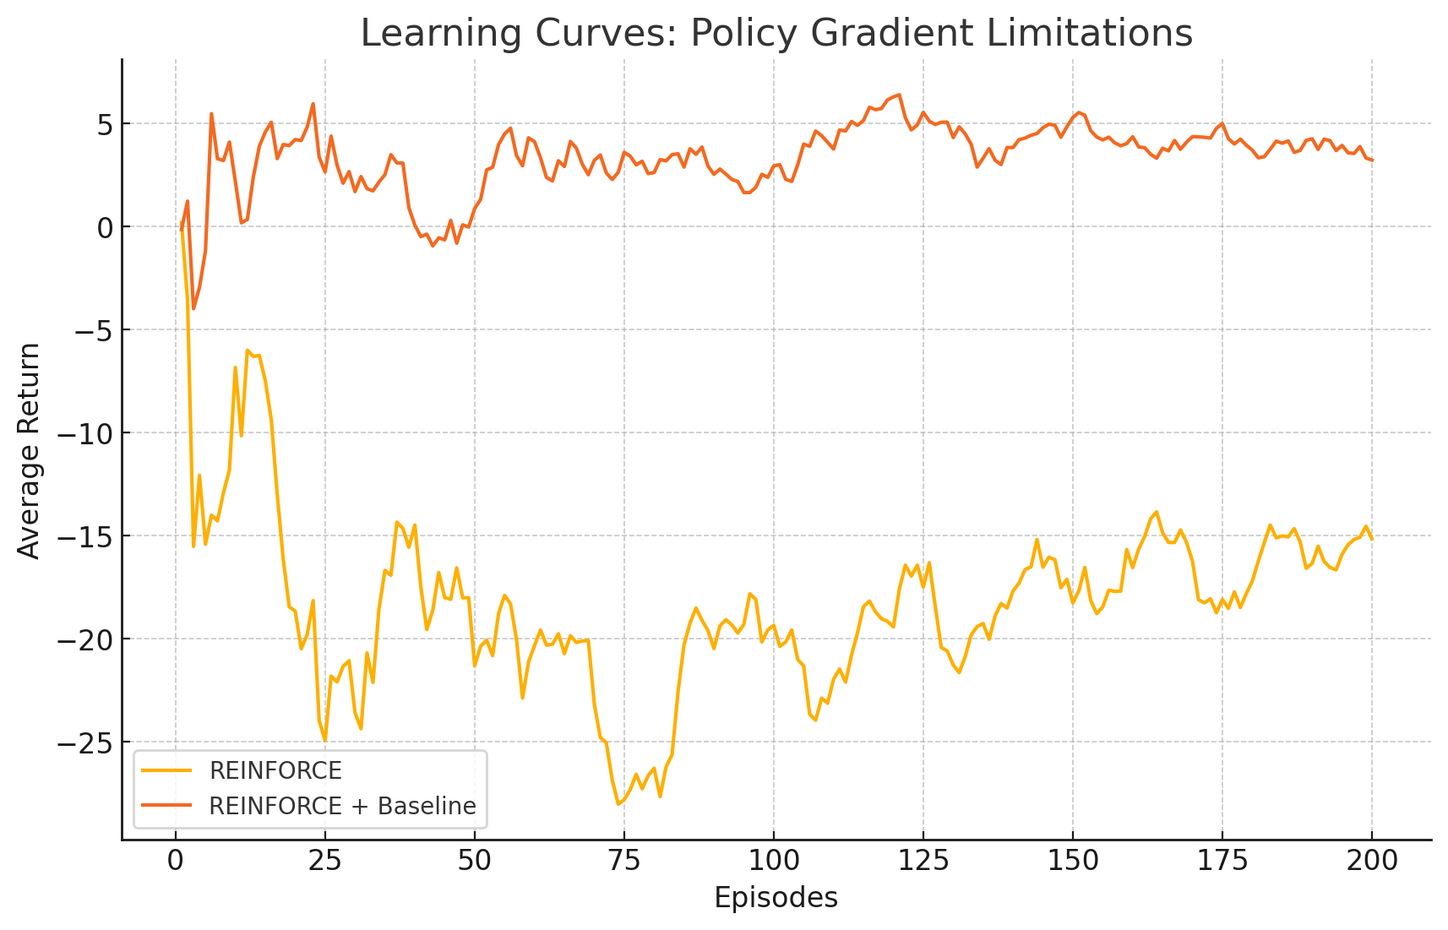
Policy Gradient Limitations
Visualization of two learning curves over 200 episodes:
Yellow line (REINFORCE)
Very high variance in returns
Slow, unstable improvement
Often dips sharply before any consistent upward trend emerges
Orange line (REINFORCE + Baseline)
Much smoother curve
Faster rise in average return
Lower variance thanks to better credit assignment

Slide 3

Key Limitations of Policy Gradient Methods
High Variance & Sample Inefficiency
What: Gradient estimates ​ exhibit huge fluctuations.
Why: Every sampled trajectory can differ widely in return, and REINFORCE waits until episode end.
Example: As we saw in the previous graph, pure REINFORCE can spend dozens of episodes just oscillating with negative returns before learning a decent policy.

Slide 4
Key Limitations of Policy Gradient Methods
Slow Convergence & Poor Scalability
What: Requires thousands to millions of episodes to find good policies in complex environments.
Why: Each update uses limited information from sampled episodes; no reuse of off-policy data.
Example: Training a robot simulator with REINFORCE alone might take days of simulated time to achieve modest control.

Slide 5
Key Limitations of Policy Gradient Methods
Local Optima and Sensitivity to Hyperparameters
What: Direct policy optimization can get stuck in suboptimal policies.
Why: Non-convex optimization landscape; step-size and network architecture choices greatly affect performance.
Example: In a maze-navigation task, the agent might converge to a “go in circles” policy if the learning rate is too high or too low.

Slide 6
Key Limitations of Policy Gradient Methods
Poor Credit Assignment in Sparse-Reward Tasks
What: When rewards are rare (e.g., only at episode end), it’s hard to know which actions were beneficial.
Why: REINFORCE attributes the same total return to all actions in the episode.
Example: In a treasure-hunting game where the agent only gets +1 at goal and 0 elsewhere, the policy gradient signal is almost pure noise for long episodes.

Slide 7
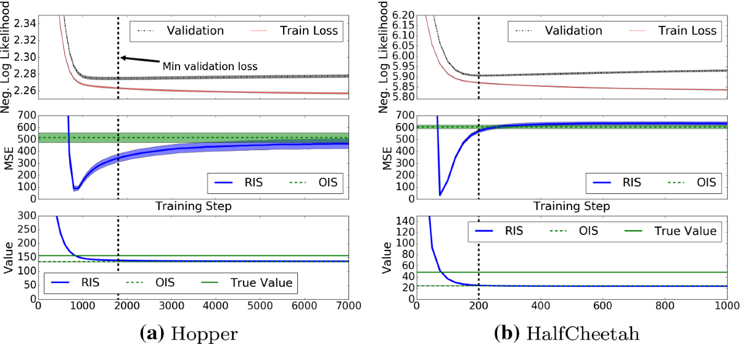
Importance Sampling

Slide 8
Importance Sampling
A powerful technique for evaluating or improving a policy using data collected from another policy
It’s crucial when learning off-policy, i.e., when the behavior policy (used to generate data) is different from the target policy (which we want to evaluate or improve).

Slide 9
Importance Sampling: Key Idea
Importance Sampling helps correct the mismatch between the distribution of data collected under the behavior policy b, and the distribution expected under the target policy π.
We do this by reweighting the returns using importance sampling ratios.

Slide 10
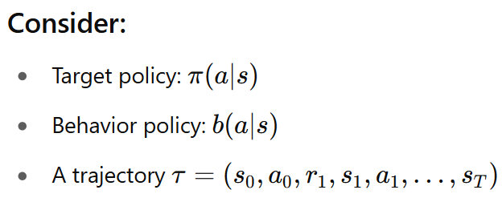
Mathematical Formulation

Slide 11
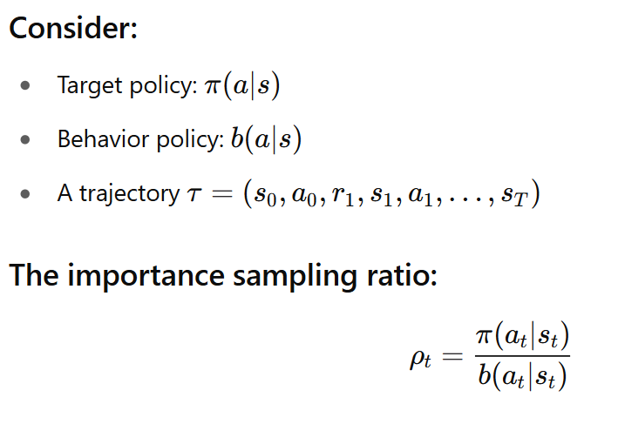
Mathematical Formulation

Slide 12
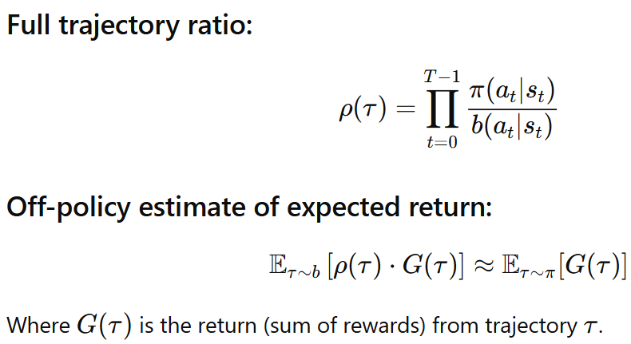
Mathematical Formulation

Slide 13
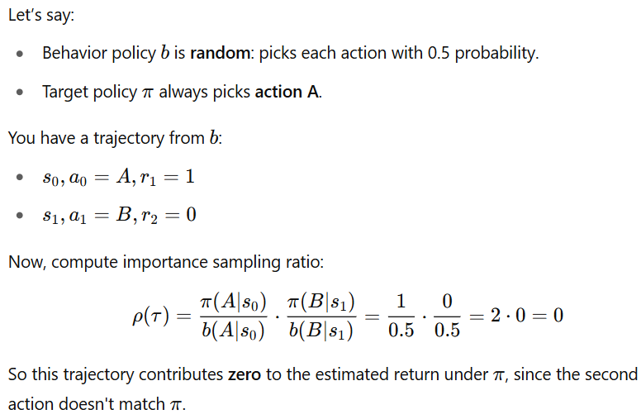
Example: Off-policy Evaluation

Slide 14
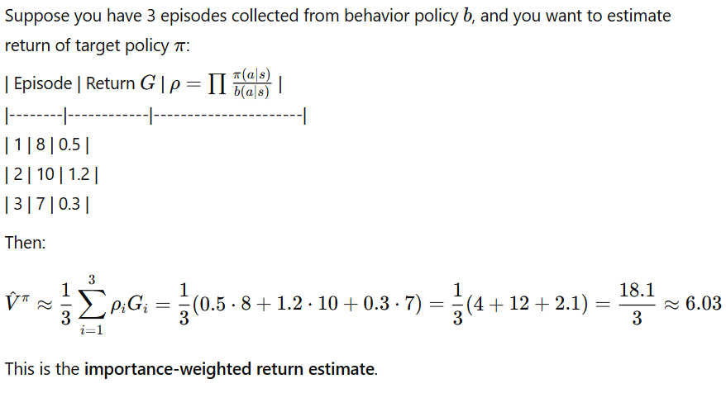

Example: Estimating Expected Return
Episode | Return G
1 | 8 | 0.5
2 | 10 | 1.2
3 | 7 | 0.3

Slide 15
Limitations
High Variance: Especially when the behavior and target policies are very different.
Zero probabilities: If b(a∣s)=0 and π(a∣s)>0, importance sampling is undefined.
Exploding products: For long trajectories, product of ratios can explode or vanish.

Slide 16
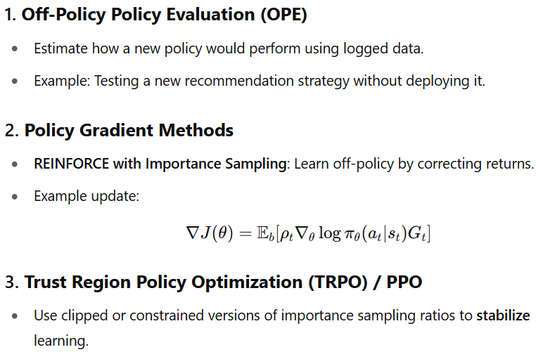
Real Use Cases

Slide 17
TRPO (Trust Region Policy Optimization)
TRPO is an on-policy, policy gradient algorithm that addresses a core problem in policy optimization:
Large policy updates can collapse performance.
TRPO ensures each update doesn’t move the policy too far from the current one, using a concept from optimization called a trust region.

Slide 18
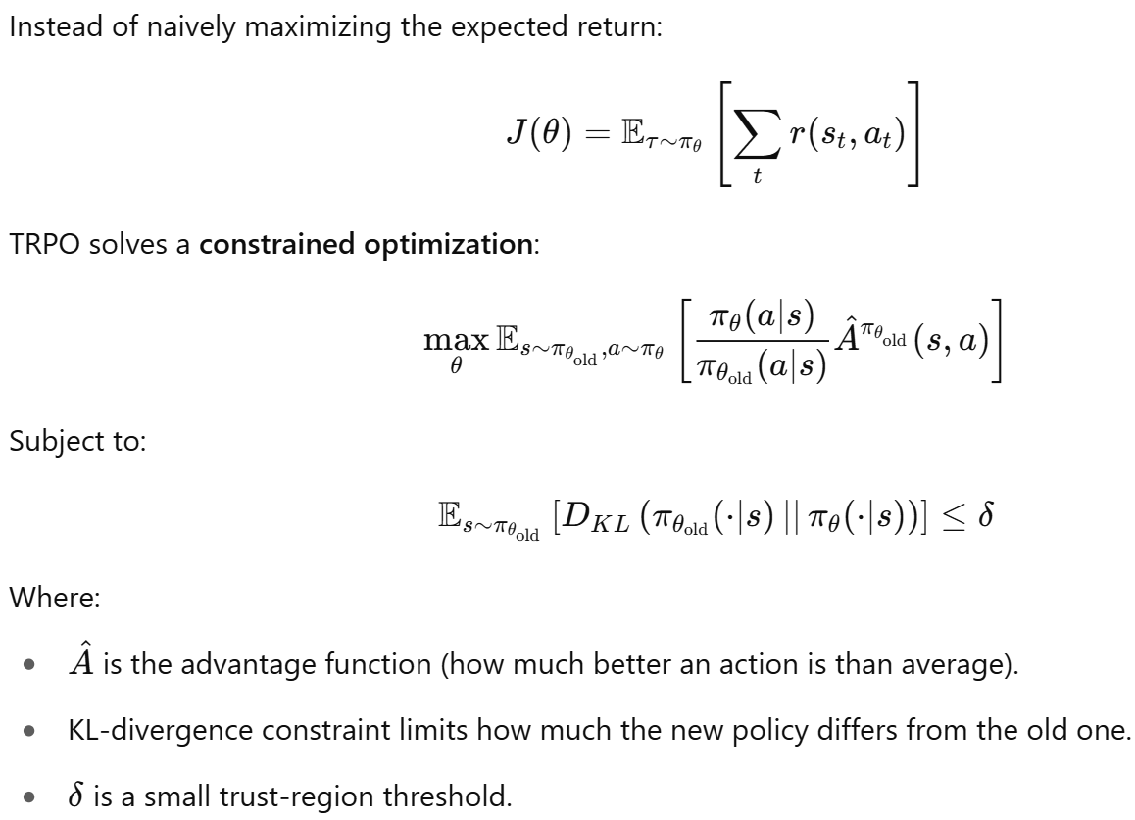
TRPO

Slide 19
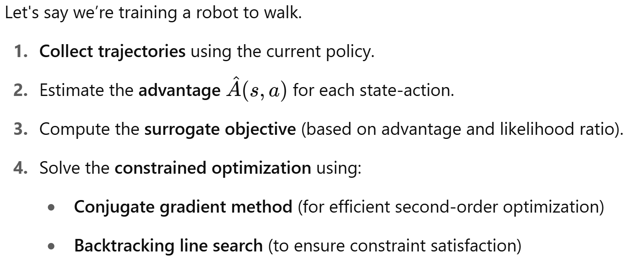
TRPO - Step-by-Step Example

